Slide 1
Fall 2012

Slide 2
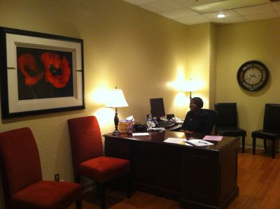
Academic Advising and Student Services Center
Advising and Career Counseling
Degree Plans
Major Changes
Graduation Plans
Late Adds and Reinstatement
Resource Room
Room 127

Slide 3
Academic Advising and Student Services Center Update

Slide 4
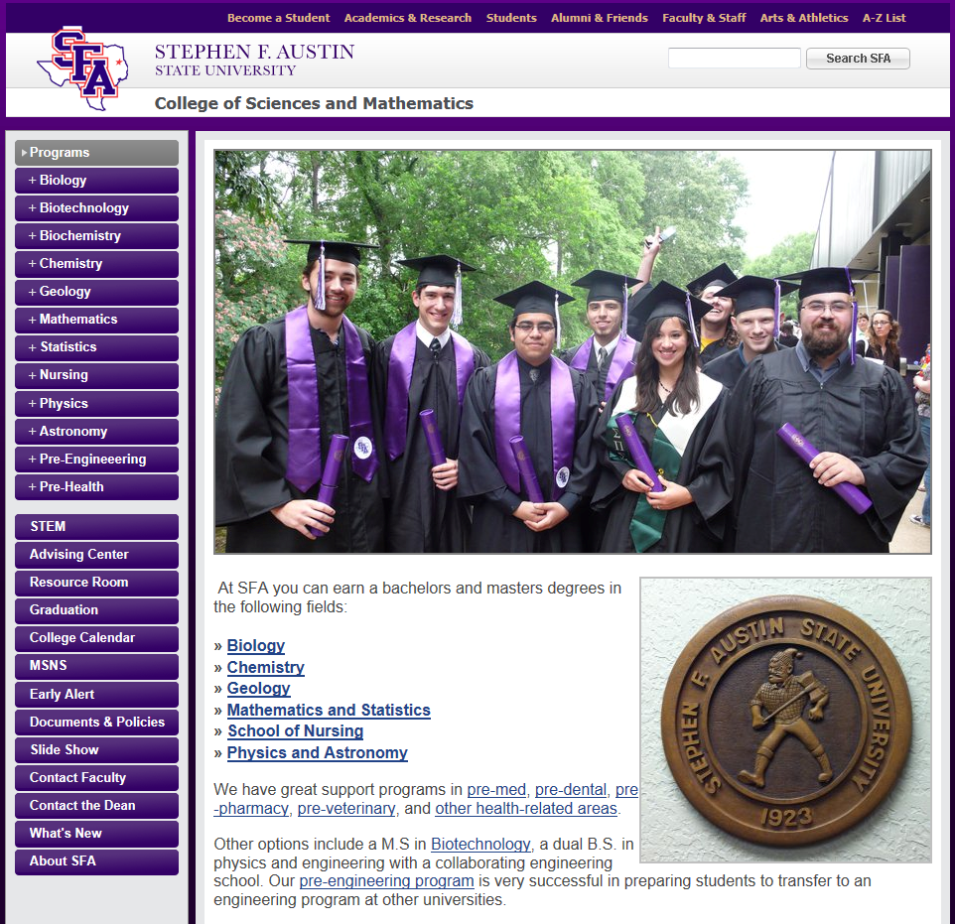

Slide 5
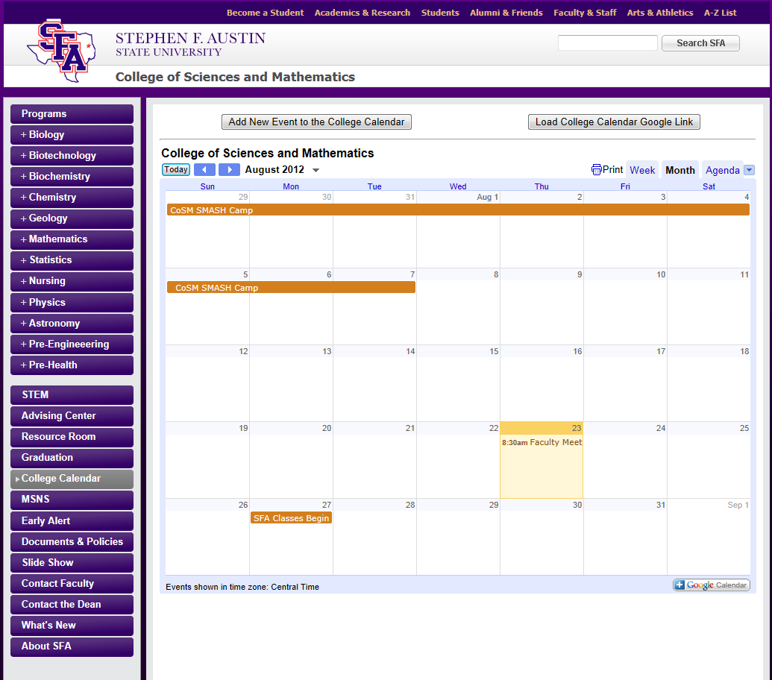

Slide 6
